Slide 1
json and JAVASCRIPT data storage
IN712 Web 3

Slide 2
A word about Assignment 2

Slide 3
Data Storage in Javascript
As a web developer you often need to store data as well as transmit data to other computers and systems
You can’t just store objects and arrays as they are;
instead, you need to serialize them.
Serialization is the process of translating an object into a string representation of that object.
Once an object is serialized, the string representation of that object can then be stored in a more permanent storage facility or transmitted to another computer.
Once you need to work with the object within JavaScript, you can deserialize it, converting it back into a native JavaScript object.

Slide 4
XML
There was a time when the web development community embraced XML markup language for everything.
Web services used it to communicate with one another and other computers, and JavaScript developers used it to communicate with the web application’s server.
XML is a human‐readable language thanks to its declarative syntax
XML has its drawbacks.
XML’s declarative syntax adds a lot of extra cruft to the data
Lots of code necessary for reading, parsing, and generating XML data

Slide 5
JSON
JSON uses several of JavaScript’s syntactical patterns for organizing and structuring data.
It’s extremely easy to parse JSON into JavaScript objects and to serialize objects into JSON.
JSON looks a lot like JavaScript’s object and array literals.
JSON lets you represent three types of data: simple values, objects, and arrays.
Simple Values
Objects
Arrays

Slide 6
JSON Simple Values
You can represent simple values like strings, numbers, booleans, and null.
“Web Programming” (JSON strings must use double quotes.)
10
true
null

Slide 7
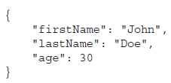
JSON Objects
Objects in JSON are represented with what looks like JavaScript’s object literal notation.
Remember that JSON is a data format, not a language
Object’s property names are surrounded by double quotes.
lack of a trailing semicolon after the closing curly brace
Javascript
JSON

Slide 8
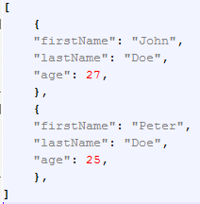
JSON Arrays
Like objects, arrays in JSON are similar to JavaScript’s array literal notation
Javascript
JSON

Slide 9
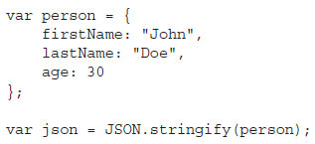
Serializing into JSON
It’s extremely easy to serialize JavaScript objects into JSON. JavaScript has an aptly named JSON object
All major browsers support this JSON object.
To serialize a JavaScript object into JSON, you use the JSON object’s stringify() method.
The json variable can now be used to send data to the server, store data locally…

Slide 10
Parsing JSON
Parsing JSON into JavaScript objects is simple.
The JSON object has a parse() method that returns the resulting object.
Using the json variable from the previous code:

Slide 12
Data Storage
Our goal as website programmers should be to make the website experience as easy and pleasant for the user as possible
One way of doing this is learning about your users and using information gained about them to personalize the website
a user, whose name you asked on the first visit, returns to your website.
You could welcome a user back to the website greeting by name.
By already knowing the user’s purchasing details, such as credit‐card number and delivery address, you can allow the user to go from viewing an item to buying it in just one click,
based on information, such as the previous purchases and browsing patterns of the user, recommendations can be made

Slide 13
Data Storage
Such personalization requires that information about users be stored somewhere in between their visits to the website.
Accessing the user’s local filesystem from a web application is pretty much off limits because of security restrictions included in browsers
However, as a website developer you can store small amounts of information
in a special place on the user’s local disk, using what is called a cookie
in the browser using HTML5’s Web Storage.

Slide 14
Cookies
The key to cookies is the document object’s cookie property.
Using this property, you can create and retrieve cookie data from within your JavaScript code.
You can set a cookie by setting document.cookie to a cookie string.
http://liveweave.com/CiuMga

Slide 15
The Cookie String
When you are creating a cookie, you can set six parts: name, value, expires, path, domain, and secure
The latter four of these are optional.

Slide 16
Name and value
The first part of the cookie string consists of the name and value of the cookie.
The name is used so that you can reference the cookie later
The value is the information part of the cookie.
This name/value part of the cookie string is compulsory
The value for the cookie is a primitive string
semicolons are used to separate the different parts of the cookie within the cookie string.
By default cookies have a very limited lifespan (i.e. the length of time the information will continue to exist.)
If you don’t set an expiration date, a cookie will expire when the user closes the browser.

Slide 17

expires
If you want a cookie to exist for longer than just a single user session, you need to set an expiration date using the second part of the cookie string, expires
The format of the expiration date is very important. It should be the same format the cookie is given by the toUTCString() method.
In practice, you’ll probably use the Date object to get the current date, and then set a cookie to expire three or six months after this date.

Slide 18
path
cookies are specific to a particular web domain, such as www.op.ac.nz ,
Cookiess are also specific to a particular path on that domain.
For example, if a page in www.op.ac.nz/students/ sets a cookie, only pages in that directory or its subdirectories will be able to read and change the cookie.
If a page in http://www.op.ac.nz/enterprise/ tried to read the cookie, it would fail.
what if you want to view your cookies from two different paths on your server?

Slide 19
path
Say, for example, you have an online store at www.wine.com/mystore/
you subdivide the store into subdirectories, such as www.wine.com/mystore/Red and www.wine.com/mystore/White
You can use the path part of the cookie string to specify that the path of the cookie is /mystore even if it’s being set in the www.wine.com/mystore/Red subdirectory

Slide 20
domain
By default, cookies are available only to pages in the domain in which they were set.
For example, if you have your first website running on a server with the domain http://red.wine.com and you have a second website running under http://white.wine.com , a cookie set in one website will not be available to pages accessed under the other domain name, and vice versa.
Most of the time, this is exactly what you want, but if it is not, you can use the domain part of the cookie string to specify that a cookie is available to all subdomains of the specified domain.

Slide 21
secure
The final part of the cookie string is the secure part.
This is simply a boolean value
if it’s set to true the cookie will be sent only to a web server that tries to retrieve it using a secure channel.
The default value, which is false, means the cookie will always be sent, regardless of the security.
This is only applicable where you have set up a server with SSL (Secure Sockets Layer).

Slide 22
Getting a Cookie’s Value
The cookies are retrieved in name/value pairs, with each individual cookie separated by a semicolon
The expires, path, domain, and secure parts of the cookie are not available to you and cannot be retrieved
The document.cookie property enables you to retrieve only all the cookies set for a particular path and
there’s no simple way of just getting the value of a cookie with the name Age.
To do this you’ll have to use the string manipulation techniques

Slide 23
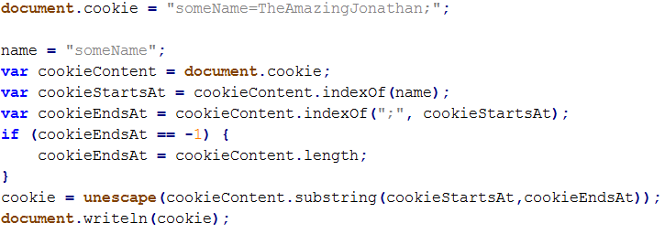
Getting a Cookie’s Value

Slide 24
Cookie limitations
A user may disable cookies
Number and information limitation
Browsers set up upper limits for the number of cookies a domain can store
Each cookie pair ( the name and value of the cookie combined) must not be more than 4KB in size
Browsers also set up upper limits for the number of cookies ( from all sorts of domains) that they can store
When that limit is reached, all the cookies, regardless of the expiration date, are often deleted

Slide 25
Cookie limitations
Reading a cookie requires a lot of code
Cookies are not a browser feature, but a feature of HTTP.
the browser sends them to the server on every request. This is useful for applications that live on the server, but it’s unnecessary for JavaScript that runs in the browser
Take home message:
Cookies can be useful
But they are a tool designed for a different time (with a different web)

Slide 26
Web storage
HTML5 introduced a new feature called web storage
it solves each of cookies’ aforementioned problems
web storage has been moved out of the HTML5 specification and into its own (which is named Web Storage).
It consists of two components:
session storage
Local storage
It stays within the browser and is not transmitted to the server. It is storage for JavaScript developers.
It provides significantly more storage space.
Chrome and Firefox support 5MB per domain
The data stored in local storage never expires
it remains until you or the user deletes it.

Slide 27
Web storage
The data stored in web storage is associated with a unique name.
we refer to this name as a key, and the data associated with a key is referred to as the value
we refer to the key and its value as a key/value pair
You access local storage using the localStorage object (session storage is accessed through sessionStorage), and it makes it easy to set, get, and remove data
We will focus on local storage, but you can apply the same concepts to session storage

Slide 28

Setting data with web storage
The localStorage object exposes a method called setItem(), and its purpose is to set a value associated with a given key

Slide 29
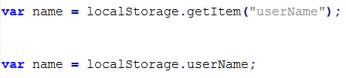
Getting data with web storage
Retrieving data from local storage is straightforward

Slide 30

Removing data with web storage
You might want to remove some data that you stored in local storage

Slide 31

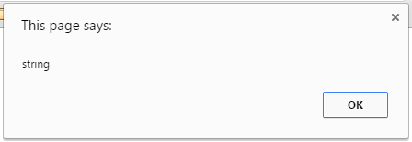
Note about storing data as strings
web storage is a string‐only data store
If you try to store some other type of value (like a number) or object, it is converted to a string and stored as a string

Slide 32
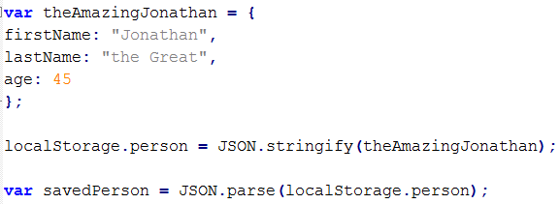
Note about storing data as strings
For storing complex objects
we need to serialize objects into JSON for storing them
We need to parse them back from JSON storage into actual objects when retrieving information.

Slide 33
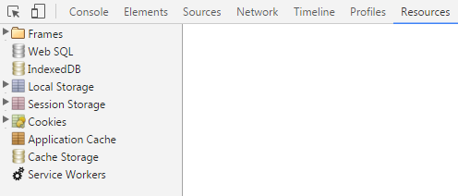
Checking web storage

